Slide 1
SEQSUMM - Sequence Summarizer
Project Advisor: Simon Shim and Younghee Park
Team Members: Gunjal Gupta
Heli Sanjaykumar Patel
Leonid Grekhov
Shaunak Anirudha Bhatlawande

Slide 2
About
News consumption
Summarization to save time
More accurate summarizations
Acceptable request times

Slide 3
Use cases
Create a user account
View current news through several categories
Summarize news upon request
Bookmark articles the user found interesting

Slide 4
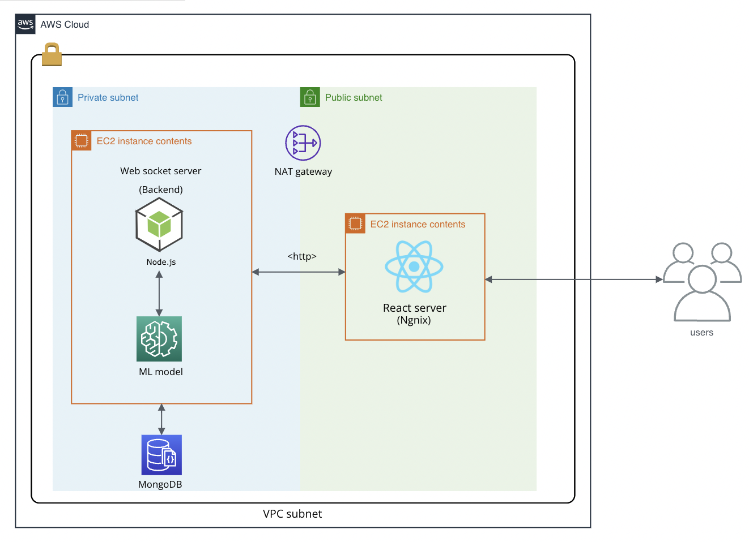
Deployment

Slide 5
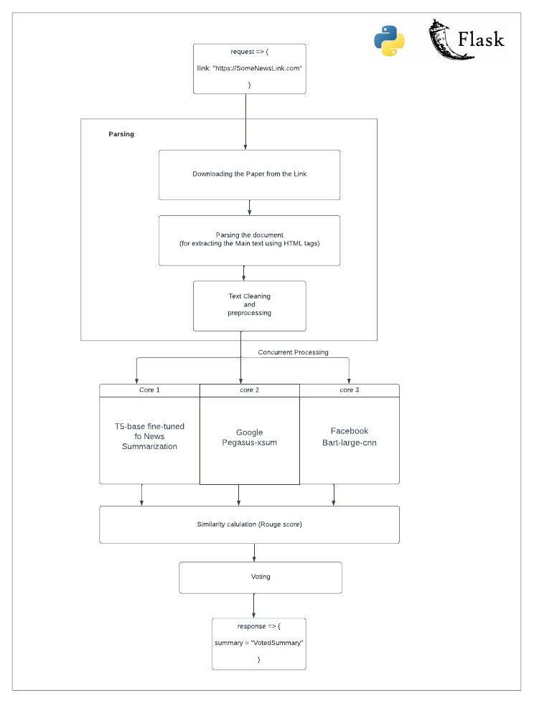
ARCHITECTURE DIAGRAM

Slide 6
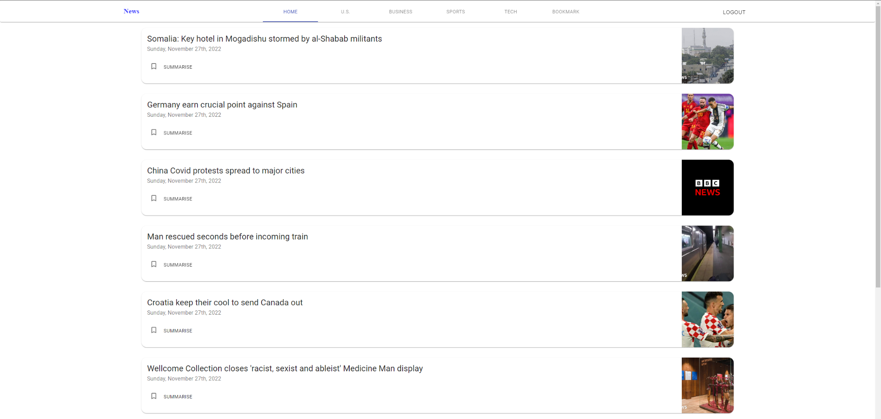
User interface

Slide 7
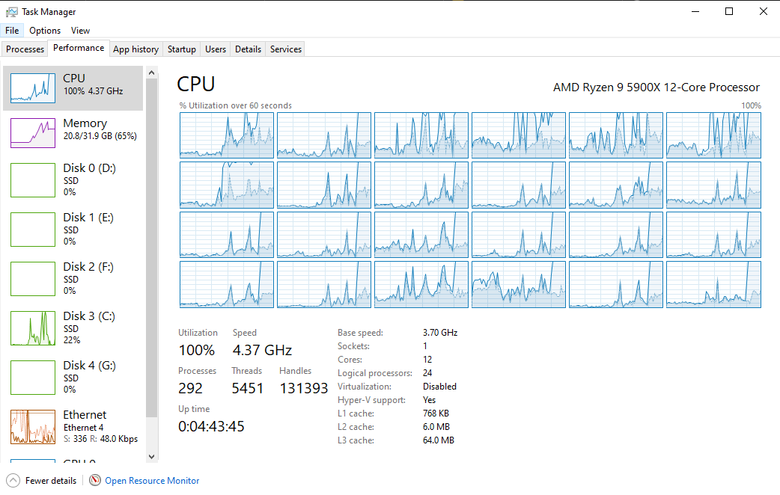

Slide 8
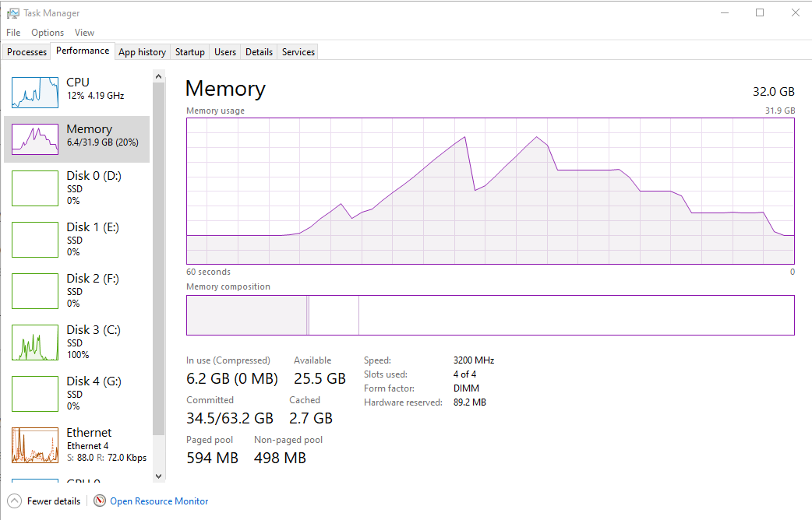

Slide 9
Thank you

